Slide 1
AUDIENCE ANALYSIS
Lecture by Ms. Maryam Ali Khan
Technical Business Writing
Department of Computer Science
FAST-NU Peshawar

Slide 2
AUDIENCE
Individual or group of readers/ listener
Difference between audience of technical work and other: importance of audience
Technical Document => Reaction
Other Document => No reaction
Response of audience
follow procedure make decision solve problem

Slide 3
AUDIENCE RECOGNITION
Ask yourself:
  Who is your reader?
  What is his level of understanding?
No perfect document without answer known/audience recognition
Inappropriate diction:
  Jargon
  Acronym

Slide 4
CONTINUED…
Inappropriate tone:
-Too dictatorial for management
-Too lax for subordinate
Know audience profile for better documentation

Slide 5
AUDIENCE PROFILE
High-tech Audience
Low-tech Audience
Lay Audience

Slide 6
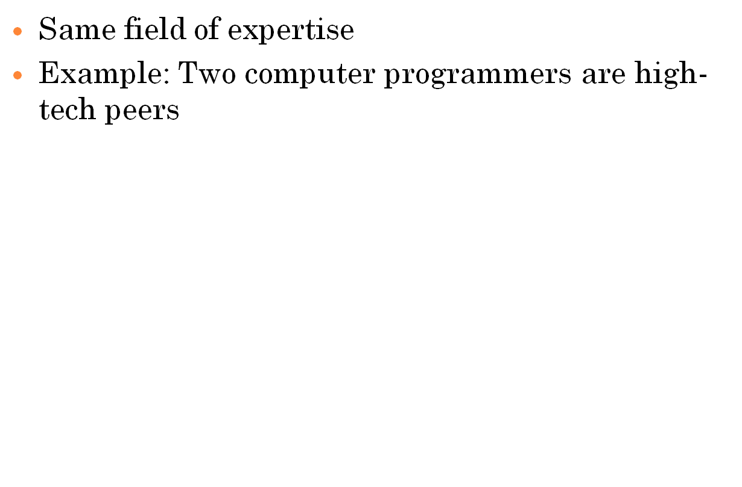
HIGH-TECH AUDIENCE

Slide 7
CHARATERISTICS OF HIGH-TECH AUDIENCE
Experts in same field, example two people working on same project
Compatibility
  Similar education
  Similar level of understanding
  Similar work experience
Jargon, acronyms or abbreviations known
  Example: MHz= Mega herts (unnecessary or offensive if explained)

Slide 8
HOW TO DEAL WITH HIGH-TECH AUDIENCE
Give minimum or no details(standard procedure, scientific/mathematical theories)
Little background info unless project is new
-Example: Status report to old/new supervisor
Use jargon, acronym or abbreviation alone
  Ex. HTTP

Slide 9
LOW-TECH AUDIENCE
Familiar with the field but do not know details
Co workers in other departments(boss, subordinates, people from other companies)

Slide 10
CHARACTERTISTICS OF LOW-TECH AUDIENCE
Understand some jargons, abbreviations
Have little background knowledge

Slide 11
HOW TO DEAL WITH LOW-TECH AUDIENCE
Give little background info
Preferable to define concepts
Use acronyms, jargons or abbreviation with parenthetical definition
Ex. HTTP (Hypertext Transfer Protocol)

Slide 12
LAY AUDIENCE
No work experience or common knowledge
Example: Manual of an equipment for a user

Slide 13
CHARACTERISTICS OF LAY AUDIENCE
Unfamiliar with subject matter
No knowledge of procedure or scientific methods
Jargon, acronym and abbreviations not known

Slide 14
HOW TO DEAL WITH LAY AUDIENCE
Write in simple language
Depth of detail
Simple graphics
Background info
Avoid high-tech terms or give detail
Explain acronyms or abbreviation
-Ex. HTTP (Hypertext Transfer Protocol) is a computer access code providing secure communications on networks.

